Slide 1
North Shore Key Club Alcohol & Substance Abuse Education Preparing you to make good decisions

Slide 2
Why are we here today?
Peer pressure
Adolescence
A real recent problem across America, especially on Long Island

Slide 3
Group Activity
Peer Pressure
Alcohol
Smoking
Marijuana
Heroin

Slide 4
How does peer pressure relate to drinking and abusing drugs?
Peer pressure is influence that a group or an individual pushes onto another person that encourages that person to change their attitude, values, or behaviors. This applies to the encouragement of risky behaviors such as smoking, drinking, and abusing drugs

Slide 5
How to prepare for it
Things to know about peer pressure:
Pressure will not only come from obvious people and places
Your best friends can be the people to pressure you
If you know something is going to happen then just don’t go
Communication with family
Always be ready to say no

Slide 6
Ways to Say No and Still be Cool
Have set excuses you could use
Have a deal with your parents
Don’t over think situations
How to act in certain situations
Be yourself
Surround yourself with your own group of friends

Slide 7
So why is saying no so important?

Slide 8
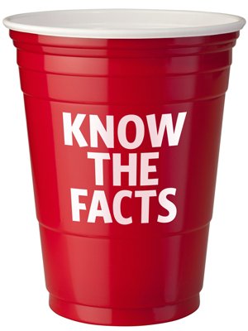
Alcohol
About 22.7% of people ages 12–20 reported drinking alcohol in the past month
More than 4 in 10 people who start drinking at 15 eventually become alcoholics
4,358 people under age 21 die each year from alcohol-related situations
Over 190,000 people underage visit an emergency room for alcohol-related injuries a year

Slide 9
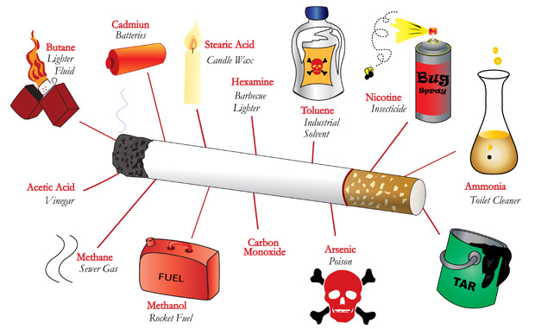
Smoking

Slide 10
Marijuana
In America, 15% of 8th graders and almost 50% of 12th graders have used marijuana, or pot
Addiction is not only possible, but prevalent!
Mental health problems, chronic cough, frequent respiratory infections
Potential loss of IQ points when repeated use begins in adolescence.

Slide 11
Heroin
CDC says nationwide heroin deaths up 45% from 2006 to 2010
From 2010-13, death toll increased 91% in Nassau County and 163% in Suffolk County
In 2013, 144 people died from heroin alone in LI
From substance abuse in general, 1 person dies a day in LI alone

Slide 12
If you are in trouble
If you are being pressured, or you have made a bad decision, do not be afraid to call a parent or friend
Parents, friends, and family are there to help
Mistakes happen

Slide 13
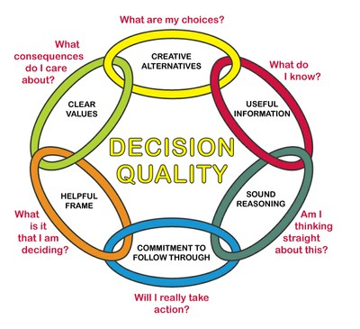
Think before you act!
Be Aware of the Consequences
Decisions can change your life

Slide 14
Thank you for your time!
Feel free to ask us any questions you may have
Substance abuse event on Wednesday, January 6th- all are welcome!

